Slide 1
NUvention - Business Pitch
Kevin Chen, Ignacio Naveiras, Penny Wang, Florent D’Souza

Slide 2
Pitch Outline
Problem-Need & Customer Segments
Solution & Demo
Value Proposition
Competitive Advantage
Next Steps

Slide 3
Problem
Locating previously encountered content online
Workarounds are counterintuitive
  Clipping and bookmarking tools require sorting and formatting effort
  User created tags and categories are not systematic
Notes:
Scenario:
Jenny is a heavy Internet user like everyone else in this room. She constantly has multiple projects going on, and what adds to her stress is that she has to keep track of everything she’s looking at. Using evernote, or any other note-taking tools just take up too much of her time to organize and format.
Problem:
Most, if not all, our interviewees face a problem with going back to clusters of content, whether articles that are project related or topic related. Some of them spend copious amounts of time tagging and clipping on Evernote. Others, bookmark pages with little to no attention paid to categorizing and formatting, thus leading to pain in accessing the page at a later date. There are some who even use the old-school method and copy paste links on to a Word document or email themselves a page. Everyone admits his or her workaround is inefficient. Users refer to it as “their system” – but it actuality, when further probed and questioned, they knew it’s a problem and a pain point. There simply doesn’t exist a smart enough tool to analyze browsing history and automatically categorize it into buckets that are relevant to the user.

Slide 4
Need
To get rid of the “save for later and then look back up” paradigm:
What if I had a tool that automatically logs, mines and categorizes my Internet usage to present it in meaningful categories so that I can easily revisit any item?
Notes:
Need:
Breadrcrumbs prides itself over the automated nature of capturing browsing data and presenting it to the user. This is the main pain point that our interviews have identified and that’s the need that Breadcrumbs is solving.

Slide 5
Market
Target segment: U.S. college students
  21 million
  Content-heavy Internet users
  Easily accessible in lean startup phase
Expand to cover broader Internet user groups
  No barriers for this expansion
Notes:
The primary customer segment is college students. For two main reasons – college students are heavy internet users who use the Internet from an extensive range of purposes – research, job hunt, information, news, so on and so forth. They are less likely to have a sophisticated and efficient system to improve productivity. They have data of a variety of subjects for Breadcrumbs to categorize, and with a higher volume of pages, the need for Breadcrumbs increases.
The second reason is, at this lean stage of development, our access to the college student is easy – since we are on a college campus, doing user testing and simulation will be of ease to us,

Slide 6
The Breadcrumbs solution
Chrome extension logs all* web navigation
  Download and login only – no clipping!
Backend process sorts pages into categories
  Data-driven categorization, Amaral
Web dashboard presents content
  Data-driven prioritization and display
→ Demo
* All non-incognito!
Notes:
Reiterate, whilst demo-ing, the problem-solution-need bit.

Slide 7
Value Proposition
Automatically categorized content saves users clicks, time and stress.
Notes:
We aim to save user time and effort by reducing the number of steps they need to take to organize their resources.
How will we make money? We don’t know yet! We do know that we will have a lot of data to work with, which may open up the potential to make some money. We also know that Breadcrumbs, at a later stage will have plenty of additional features – which also may open up possibilities of a pro version for a fee. However, none of these plans are confirmed at the moment..

Slide 8
Breadcrumbs is…
Focused exclusively on your past consumption
  unlike Google
Not a browser history
  unlike Chrome’s (repetition and vast volume)
Automated content logging
  unlike bookmarks and Evernote
Data-driven, smart categorization
  unlike bookmarks and Evernote
Notes:
This slide is about our differntiatiors (sources of competitive advantage)
One of the key insights we found from our interviews, that positions ourselves starkly from our competitors is that we are AUTOMATED – that is our value and that is our promise. No clicks, no tagging, no clipping and no sorting. All that is done for you by Breadcrumbs.
With Evernote, Pocket, Bookmarking, History – while all of these tools are good at mining data, they leave it to the user to categorize and sort the data. Breadcrums does that user part automatically.

Slide 9
Next Steps
Tighten the algorithm
  different techniques for different types of content?
  learning from past use and/or from aggregated user data?
  ability to predict revisiting?
Test at scale
  gauge performance across content types
Transform the product
  rescoping content types?
  redefining user inputs
  additional visualizaion features?
Notes:
For the next few days/weeks, we will sharpen our algorithm to achieve smart auto-categorization.
The second is – we need to test with enough scale to get meaningful performance insights. We need to see how users react technically, functionally and in terms of adoption likelihood. A real possibility in this step is that not all types of content are equally suited for our tool, or there happens to be a niche audience that finds more value in the solution for some reason. E.g. maybe people who are recruiting really value quick access to job offers browsed, or maybe online shoppers value quick access to all their product pages browsed.
Thirdly – what we have learnt in testing will translate into product pivots or enhancements. This may involve: re-scoping the content types to cover and/or treating them differently, compromising on automation (i.e. bringing in user inputs), adding extra visualizations or sorting options, and in all certainty improving the look and feel
And this three step loop will continue for most if not all of next quarter.

Slide 10
Common Pitfalls
Not telling a story/reading slides
Too much shtick/acting
Too many slides (1-2 minutes per)
No passion/not compelling
Come across desperate/not confident
Demo runs long or does not work
Not understanding audience
  Should assume audience is angel investors
Answering all potential questions in presentation
Information Slides – For Reference

Slide 11
Pitch Feedback
Dry Runs on 3/3
Schedule time with AB mentors and Faculty Adviser to get their feedback prior to 3/10
Information Slides – For Reference

Slide 12
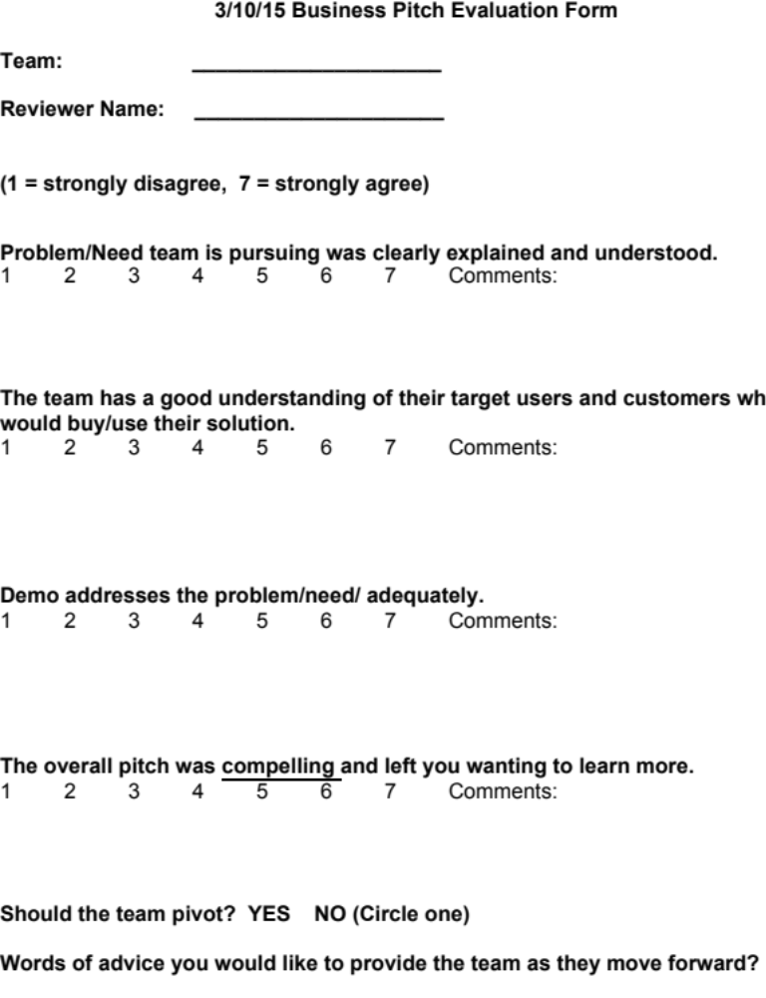
Information Slides – For Reference

Slide 13
Pitch is Iterative Process
Drafts due to faculty by Saturday at 6:00pm
Faculty will give you initial feedback to incorporate into 3/3 dry runs
Pitch is a selling exercise
  What is your pitch goal?
Be ready for hard feedback and real criticism
Information Slides – For Reference

Slide 14
3/10 Business Pitch Session Structure
Location: Allen Center
8 Minute Presentation
8 Minute Q&A
  Q&A from Advisory Board and Faculty
Reception and team meetings with AB coaches after class
Pitches will run until at least 4:30
Information Slides – For Reference
Notes:
Plan ahead with Sandeep for AV issues;

Slide 15
Problem/Need/Customer Segments
2 minutes max
What is problem, unmet/unknown need you are going after
Best told via a story/case study/role play
Why is this a problem?
Big problem/small problem? How much pain?
If listener does not believe there is a need/problem, you are in trouble
Information Slides – For Reference

Slide 16
Problem/Need/Customer Segments
Who is the primary customer segment you are going after and why
Differentiate economiccustomer from users
How do you intend to reach them?
Information Slides – For Reference

Slide 17
Solution/Demo
3 minutes
How do you intend to address this problem/need?
Why is your solution better than current alternatives?
Show MVP here-Demo goes here
  Watch timing
  Test Demo!!!!
Information Slides – For Reference

Slide 18
Value Proposition/Problem Solution Fit
1 minute max
Why is a customer hiring you?
Make or break your pitch here
Better to do from customer perspective than yours
How will you make money (Business Model) should be addressed here
Why do you believe you have Problem Solution Fit
  Highlight customer dev interviews
Information Slides – For Reference

Slide 19
Competitive Advantage
1 minute max
What are your moats?
How are you positioned against key competitors?
Highlight insights from your interviews!
Information Slides – For Reference

Slide 20
Next Steps
1 minute
What are the things you plan to do after the pitch?
Information Slides – For Reference

